Slide 1
An Analysis of Connecticut State Police Traffic Stops
Introduction to Data Science Capstone Project
Paige Williams

Slide 2
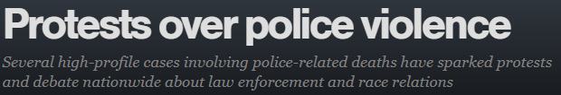

Problem
In recent years, there has been a growing spotlight on the interactions between police and citizens, causing many protests throughout the country and poor relationships with law enforcement.

Slide 3
Solution Approach
In an effort to provide an objective perspective, this project will investigate what factors, if any, can predict which Connecticut State Police traffic stops end in arrest, and will identify if any of those factors are demographic, indicating the possible prevalence of police profiling.

Slide 4
Data 1.
Dataset: Connecticut State Police traffic stops
In total, the dataset contains 24 features across 318,669 observations (traffic stops), covering the time period from 10/1/2013 through 3/31/2015.
The features are largely categorical (i.e. not numerical), including information such as the driver's gender and race, county of stop, if a search was conducted, and resulting violations.
The data set is heavily imbalanced, with non-arrests making up 97.67% of the known arrest outcomes.
Source: The Stanford Open Policing Project
Method: Since our main question is one of classification; predicting whether a Connecticut State Police traffic stop ends in arrest or not, a supervised classification machine learning algorithm was used to create a model. In addition, some visual analysis and statistical testing was performed.
As a measure of performance, Kappa and AUC were used since accuracy is not the best measure for imbalanced data.

Slide 5
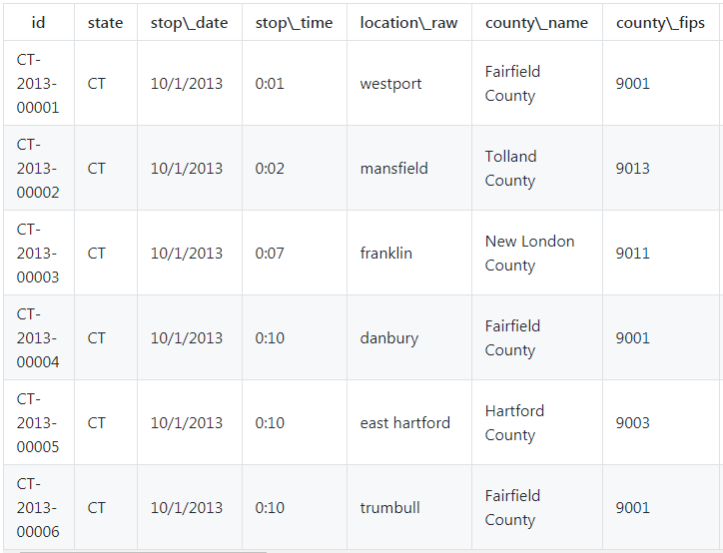
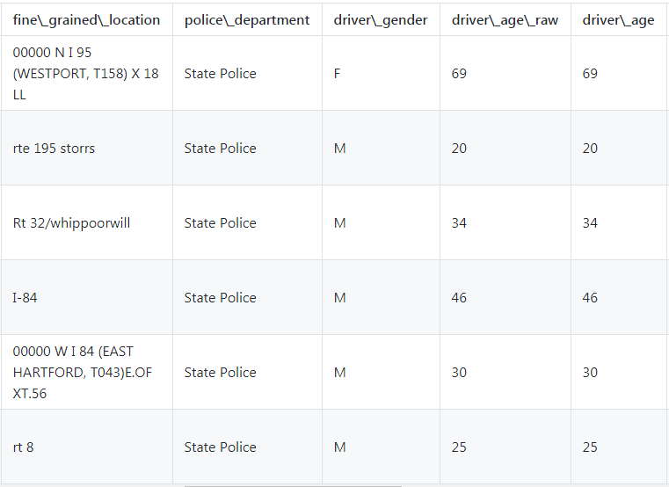
Data II.

Slide 6
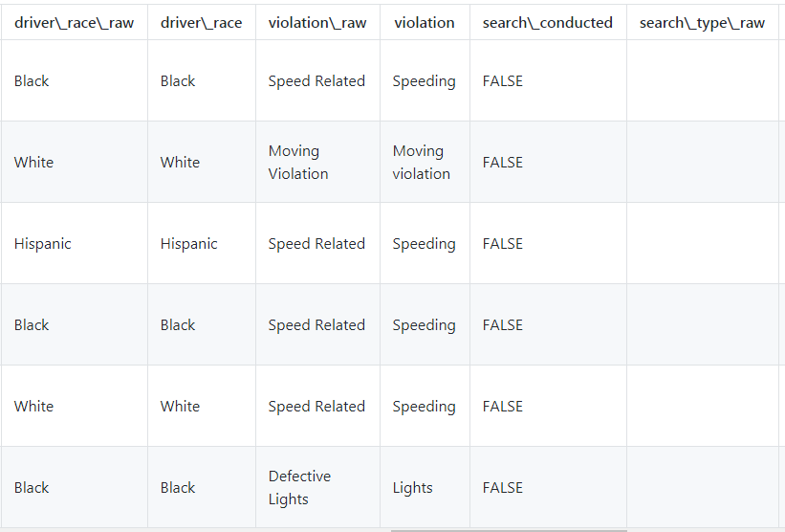
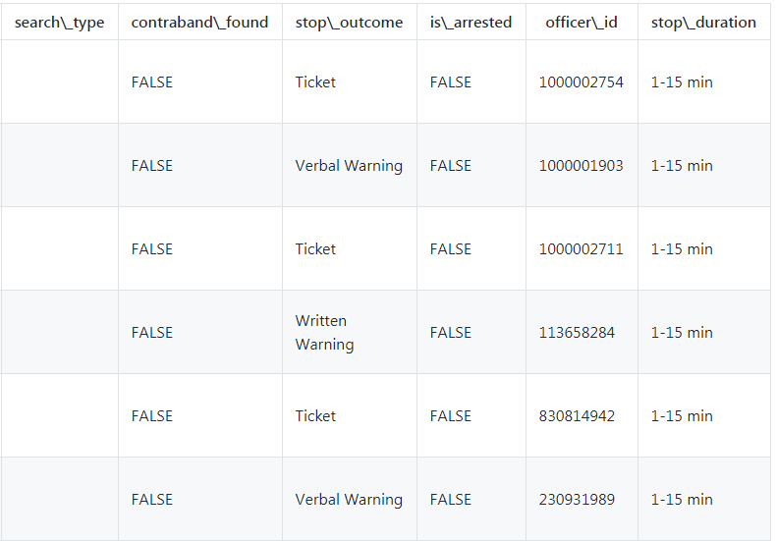
Data III.

Slide 7
Visual Analysis and Statistics
Summary: All the features tested against arrest status had statistically significant results, specifically all of the features were shown to have dependent relationships with the arrest outcome of a stop.
For some features, this makes more intuitive sense than others.
For example, features that describe the stop, like stop duration, search type, if a search conducted was conducted, and violations are more obviously going to relate to arrest status. However, characteristics of the driver; gender, race, and age, are also not independent from arrest status, a finding that requires further investigation to uncover if implicit bias is at play.
Features tested:
Driver gender
Driver race
Driver age
County of stop
Was a search conducted?
Search type
Was contraband found?
Stop duration
Number of violations
Violations
Stop time (hour)
Stop day of the week
Stop day of the month
Stop month and year

Slide 8
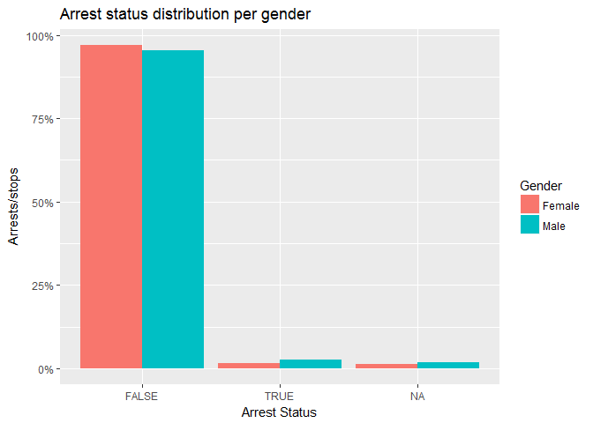
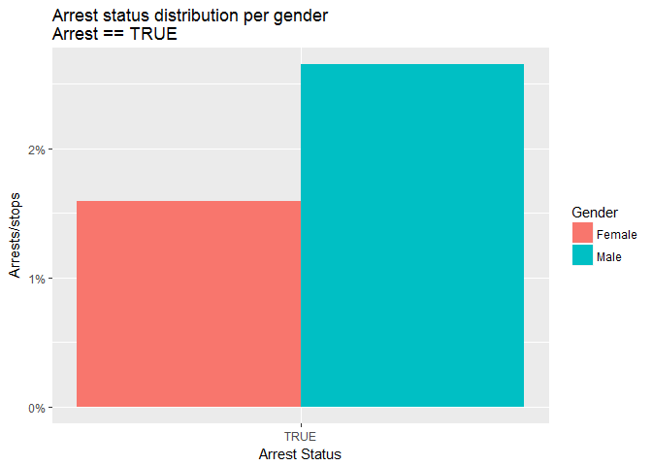
Visual Analysis: Gender
* Ratio shown is # of arrests per # of traffic stops
From the breakdown of the arrests/stops ratio by gender, we see that males who are stopped are more likely to be arrested than females who are stopped.
In fact, in this dataset, stopped men are 1.7 times more likely to be arrested than stopped women.

Slide 9
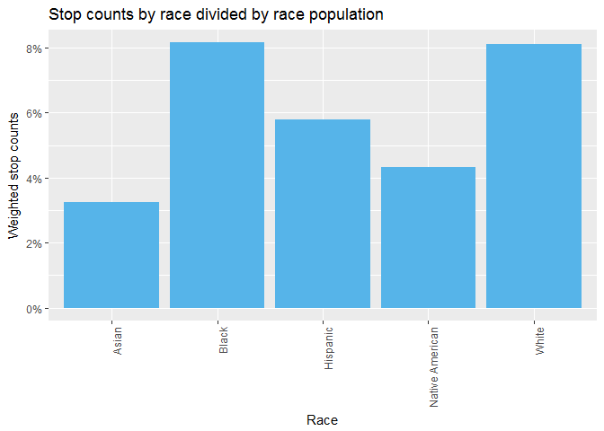
Visual Analysis : Race I.
When taking the ratio of traffic stop counts to Connecticut census race populations, Black drivers and White drivers have the highest number of stops per capita.

Slide 10
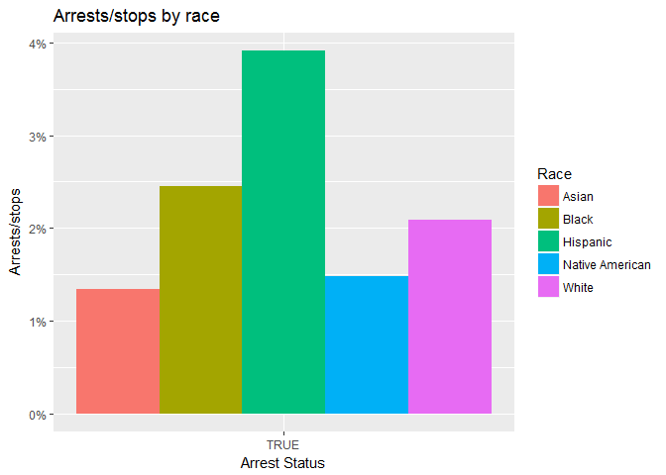
Visual Analysis : Race II.
However, when looking at the ratio of arrests/stops, Hispanic drivers and Black drivers have the highest ratios.
It is interesting to note that Hispanic drivers are the third highest in terms of stops per capita but have the highest arrest likelihood.
In fact, the arrests/stops ratio of Hispanic drivers is 1.593173 times more than the next highest ratio, which is the ratio for Black drivers.
Statistical testing showed the higher Hispanic arrests/stops ratio to be statistically significant, and not likely due to chance.
* Ratio shown is # of arrests per # of traffic stops

Slide 11
Visual Analysis: Final Thoughts
The above results seem to lend support towards the concern that race, among other demographic factors, impacts arrest status outcome, at least for Connecticut State Police traffic stops. However, these results only show correlation, not causation.
For example, different groups could behave differently, leading to different arrest outcomes. Maybe a greater proportion of stopped Hispanic drivers committed violations that require arrests compared to other races. Or maybe police officers do behave differently between different groups, indicating bias.
Both explanations could be concluded from the arrests/stops ratio discrepancies observed between the different races.

Slide 12
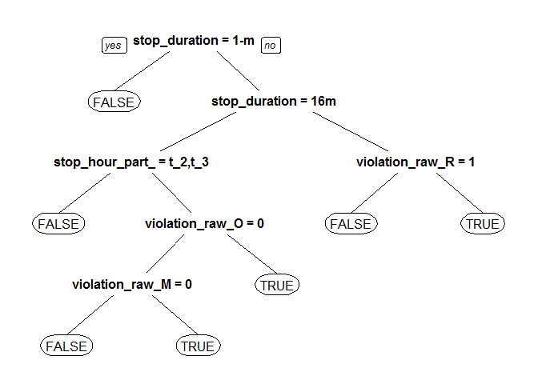
Machine Learning I.
The final model chosen is a Classification and Regression Tree (CART) utilizing a Penalty Matrix to handle our dataset imbalance.
The Penalty Matrix assigns a higher penalty for false negatives, i.e., where the model labels an observation as having no arrest when there was one. This is because we're most concerned about accurately labeling arrests.
Here’s the decision tree of the final model:
stop_duration = 1-m is for stops that lasted 1-15 minutes
stop_duration = 16m is for stops that lasted 16-30 minutes
violation_raw_R = 1 is for stops where there was a registration violation
stop_hour_part_ = t_2, t_3 is for stops that occurred between 6:00 am and 6:00 pm
violation_raw_O = 0 is for stops that did not have a violation labeled “Other”
violation_raw_M = 0 is for stops that did not have a moving violation

Slide 13
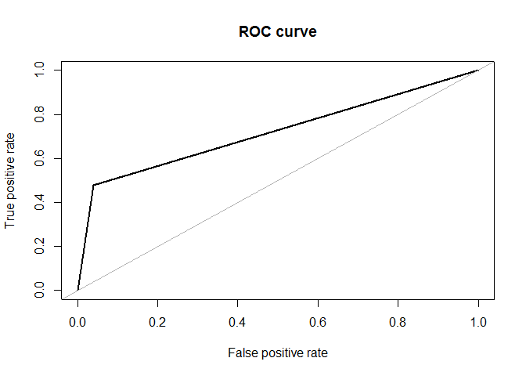
Machine Learning II.
Overall, the model did not perform well, with a Kappa of 0.2849794 and an AUC value of 0.720, where values closer to 1 indicate a good performing model.
We did, however, identify some of the more important variables for arrest status prediction:
Stop duration
Was a search conducted?
Search type
Was contraband found?
Stop time (hour)
* The ROC curve to the right is the source of the AUC value. The farther the black curve is away from the gray line, the better the model is at prediction, and the closer to 1 the AUC value is.

Slide 14
Results
The overall learnings from the machine learning investigation is that the dataset we currently have does not contain the most relevant information for creating a good model for predicting arrest status.
Because the important variables identified are not demographic, it seems to be that demographic factors don’t play a large role in predicting arrest status. In fact, since the models didn’t perform well regardless of what the important variables were, none of the features in the dataset play a large role.
This finding only debunks significant causation of the features to arrest status.
However, this doesn’t mean that the features don’t relate in any way to arrest status.
From our visual analysis, we saw statistically significant discrepancies in arrest status between different demographic populations.
These discrepancies highlight only correlation, not causation, which could explain why our machine learning algorithms didn't perform well: correlation does not equal causation.
Ultimately, to gain a better-rounded, clearer understanding of what factors are at play in arrests and if implicit bias is present, more detailed data is needed.

Slide 15
Recommendations For Police Departments I.
Collect richer data
With the current data we have, conclusions can't really be made regarding what factors influence arrest status, and therefore recommendations can't be made about what areas of police traffic stops need addressing. To get to that stage, police departments should put efforts towards collecting more robust and descriptive data.
Some suggestions include:
The contraband that was found
Car descriptors
More specific violation information
Once the data is collected, more visual analysis and algorithm testing can be done to try and uncover causation, by creating a better performing model.

Slide 16
Recommendations For Police Departments II.
Create training programs for officers
Collecting more data might not be an immediately feasible task for every police department. One way to find the root of some of the demographic discrepancies uncovered in the visual analysis section is to change police behavior through training programs. If, after the training, the outcomes are the same, police behavior might not have been the problem. If outcomes do change, maybe it was.
Create outreach programs
While we cannot yet determine the cause of different arrest likelihoods amongst different demographic groups, the disparity exists and is likely felt by many of the communities. Anecdotal evidence is an important part of understanding community feelings towards police officers. Creating outreach programs to foster positive relationships and share experiences is a powerful way to address the impact of those disparities and an important part of police being able to do their jobs well.

Slide 17
Next Steps
Conduct similar analysis throughout US
Just because we couldn’t produce a good model for the Connecticut State Police traffic stops, doesn’t mean the currently available features aren’t good predictors in other police departments.
Create standard data collection procedures
The Stanford Open Policing Project had to complete a lot of data standardization processes and some states did not have all features.
To get a holistic report and provide comparisons, standard data that is collected the same way is necessary.
Apply Natural Language Processing
Get access to written police reports to apply natural language processing and have more data about traffic stops

Slide 18
Questions?

